Slide 1
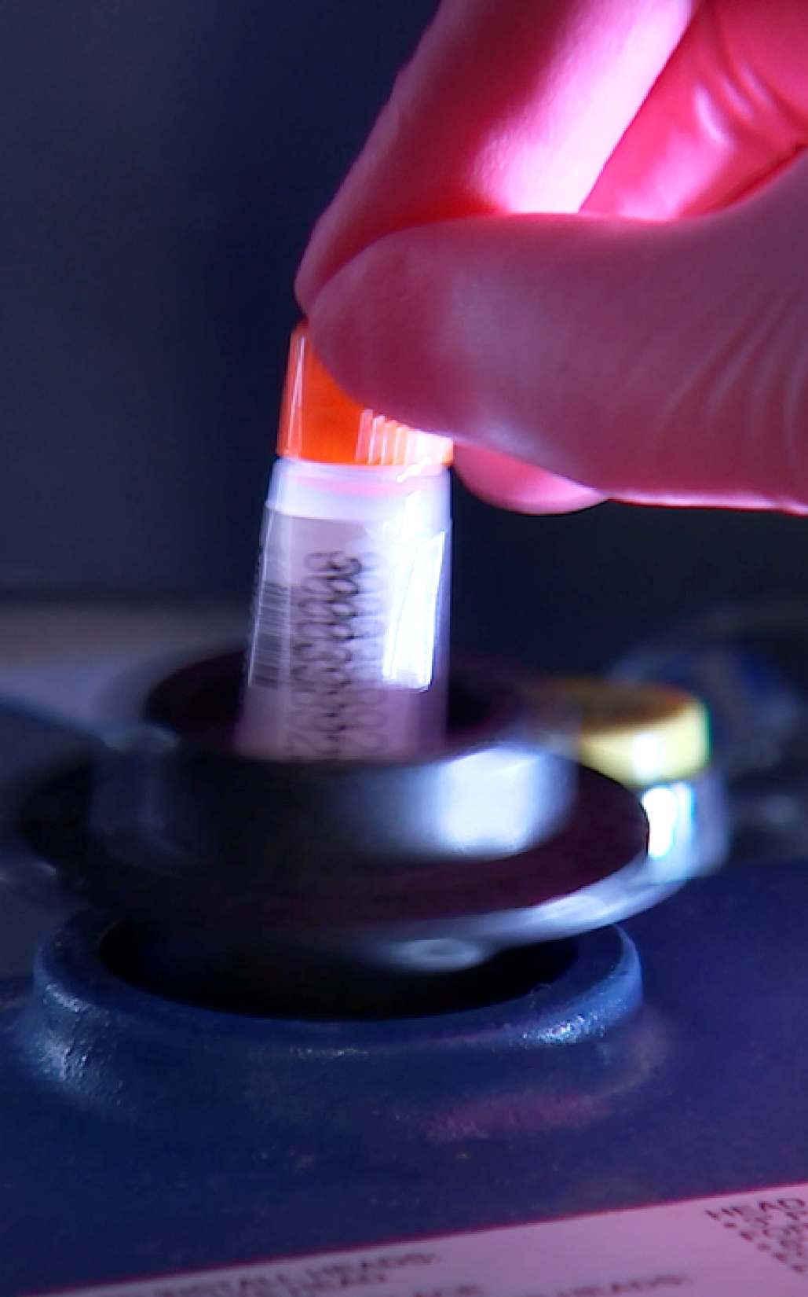
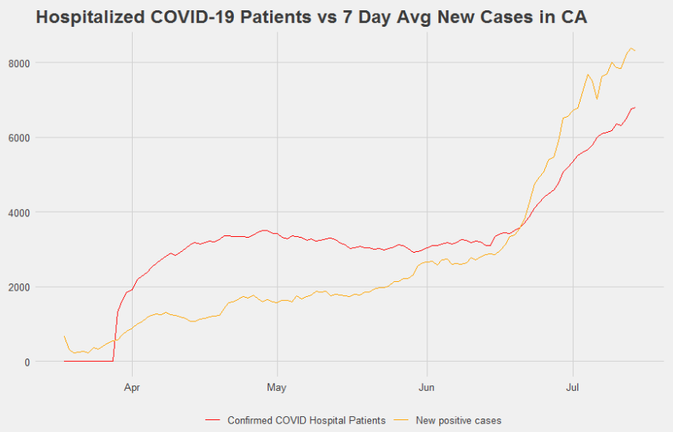

California
Notes:
Like for the US data, we used New COVID cases as a predictor in our multivariate modeling process. For California, the reported new cases had some sporadic (but non-periodic) behavior in few places so we took the average of the last 7 days of new cases and used that as our independent variable. One thing we can see right away is that these two variables appear correlated but New cases goes from trending far under the hospitalizations curve to over it in mid June, meaning there is some uncertainty to how well New Cases will perform as a predictor in the future.

Slide 2

California
Notes:
It’s also important to note that due to the recent increasing trend in both of these measures, all of these models produced forecasts that essentially continue this increase forever, even when we include the entirety of the series. As we discussed in our initial presentation, we dont believe that forecasting a continuous increase for 3 months is realistic, so none of these models were considered for a 90 day forecast.
For consistent comparison, each model was run omitting the last 7 observations to calculate an ASE.

